Slide 1

18ECC205J - Analog and Digital Communication UNIT 2
Contents of Week 2 Lecture
AM Receivers
-Superheterodyne Receiver
FM Receiver
Sources of Noise
Noise in AM System
Source: Singh. R. P & Sapre. S. D, “Communication Systems: Analog & Digital,” 3rd edition, McGrawHill Education, Seventh Reprint, 2016.

Slide 2
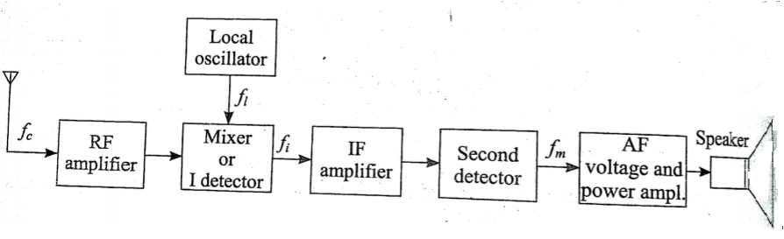
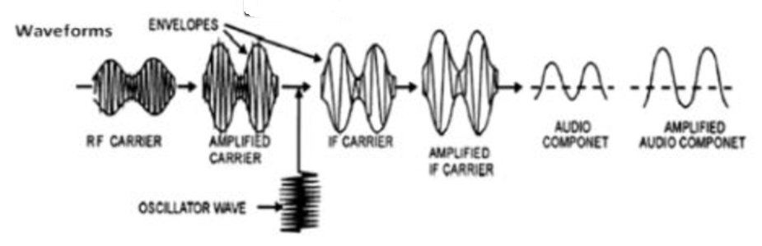
Superheterodyne receiver - AM

Slide 3
All the incoming radio frequencies are converted into a single intermediate frequency fi by heterodyning or mixing process.
Mixer is also called I detector. It generates sum and difference frequencies.
The difference frequency (fl – fc ) is selected by tuned circuit.

Slide 4
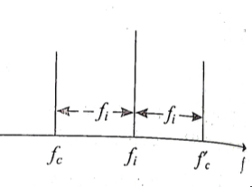
Stages of Superheterodyne receiver
RF amplifier:
Amplification of received radio frequency to provide better sensitivity and improve SNR
Rejection of unwanted signals to improve selectivity
Rejection of image signals
Image Signal
This is a signal whose frequency (fc’ ) is above local oscillator frequency (fc) by same amount as desired frequency:
fl – fc = fi or fc =fl – fi
Therefore, fc’ = fl + fi => fc’ - fc =2fi
fc’ = fc + 2fi

Slide 5
If an image signal is intercepted by antenna and reaches the mixer, it produces same IF as produced by fc.
fc’ - fl =fi
This spurious IF signal is also amplified by IF amplifier and produces interference in the receiver output.
RF amplifier add one more tuned circuit per stage to attenuate the image frequency.

Slide 6
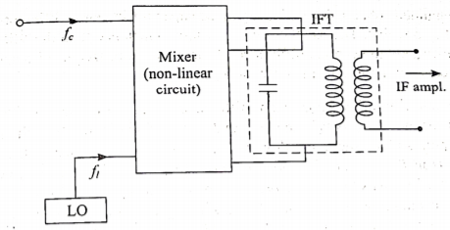
2. Mixer Stage:
Non linear device that mixes the incoming signals fl , fc and generates
fi = fl – fc
The desired IF is selected by a tuned circuit (IF transformer). The IFT is tuned by adjusting the core – inductive tuning.

Slide 7
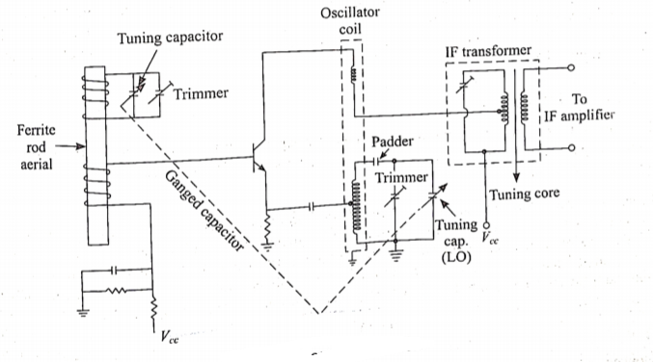
Self excited mixer
Uses a single device as local oscillator and mixer. Otherwise called Frequency tuning capacitor.
The received signal is applied to the base of transistor, local oscillator voltage develops across the emitter of the transistor.
Tuning capacitor of antenna and LO circuit are mounted on same rotating shaft (ganged to provide single dial tuning)

Slide 8
Tracking and alignment:
Ganged capacitor forms a mechanically coupled system for simultaneous tuning of a number of resonant circuits by a single knob.
RF circuit and mixer are tuned to incoming fc.
LO has to be tuned to a frequency higher than fc by fi (simultaneously done by ganged capacitor).
The LO coil has less inductance than the coil of RF section to achieve tracking (fi = fl – fc)
Tracking is done such that the difference frequency matches IF at two points along the dial, allowing some errors along rest of the dial (Tracking error).
The precise alignment of tuned circuit to achieve zero tracking error at two points along the dial is known as two point tracking.

Slide 9
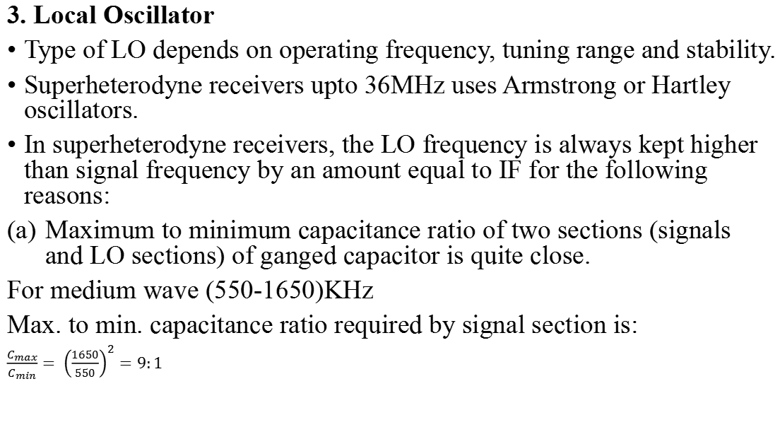
3. Local Oscillator
Type of LO depends on operating frequency, tuning range and stability.
Superheterodyne receivers upto 36MHz uses Armstrong or Hartley oscillators.
In superheterodyne receivers, the LO frequency is always kept higher than signal frequency by an amount equal to IF for the following reasons:
Maximum to minimum capacitance ratio of two sections (signals and LO sections) of ganged capacitor is quite close.
For medium wave (550-1650)KHz
Max. to min. capacitance ratio required by signal section is:
$$\frac{C_{max}}{C_{min}}= {\left(\frac{1650}{550}\right)}^{2}=9:1$$

Slide 10
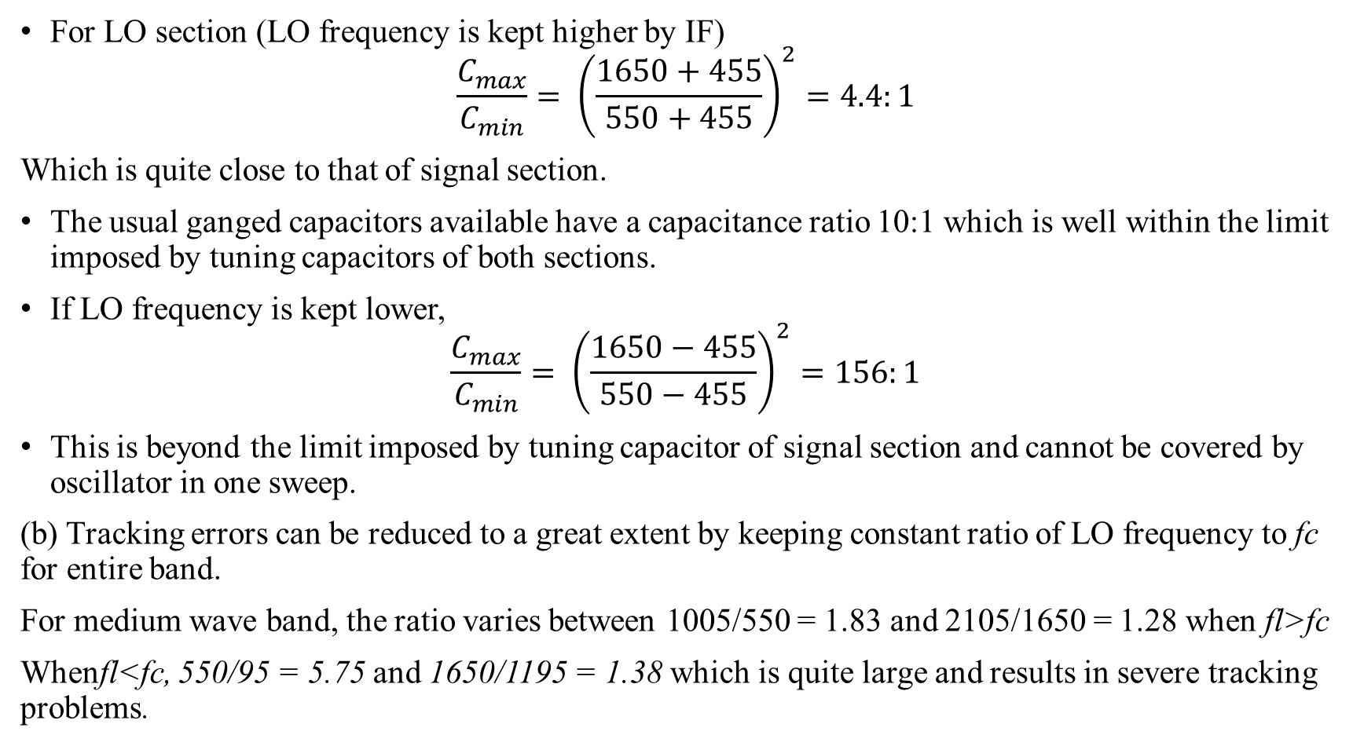
For LO section (LO frequency is kept higher by IF)
$$\frac{C_{max}}{C_{min}}= {\left(\frac{1650+455}{550+455}\right)}^{2}=4.4:1$$
Which is quite close to that of signal section.
The usual ganged capacitors available have a capacitance ratio 10:1 which is well within the limit imposed by tuning capacitors of both sections.
If LO frequency is kept lower,
$$\frac{C_{max}}{C_{min}}= {\left(\frac{1650−455}{550−455}\right)}^{2}=156:1$$
This is beyond the limit imposed by tuning capacitor of signal section and cannot be covered by oscillator in one sweep.
(b) Tracking errors can be reduced to a great extent by keeping constant ratio of LO frequency to fc for entire band.
For medium wave band, the ratio varies between 1005/550 = 1.83 and 2105/1650 = 1.28 when fl>fc
Whenfl<fc, 550/95 = 5.75 and 1650/1195 = 1.38 which is quite large and results in severe tracking problems.

Slide 11
4. IF amplifier
Tuned voltage amplifiers and provides most of receiver gain. More than one stage may be used to improve selectivity. The output appears across a tuned transformer circuit.
Choice of IF
For commercial AM receivers, fi = 455KHz. It is chosen as a compromise between 2 factors:
For proper adjacent channel selectivity and easy tracking fi should be low.
For Image frequency rejection, fi should be high.
For fif = 455KHz , baseband frequency 10KHz, Q = 455/10 = 45.5
For fif = 10MHz , Q = (10*10^6)/(10*10^3) = 1000.
Design of tuned circuit with such high Q is impractical. Thus fi should be low for proper selectivity. A low fi makes the difference between signal and Lo frequency small making the tracking easy.

Slide 12
For image rejection, fi should be large
fc’ = fc + 2fi
fc’/ fc = 1+(2fi / fc)
IF fi is kept large, the image signal can be easily rejected.
At short waves, the image signal rejection become poor due to double spotting (Signals from same short wave station is picked at two nearby points on the receiver tuning dial).
Double spotting can be avoided by having good selectivity to reject image signal.

Slide 13
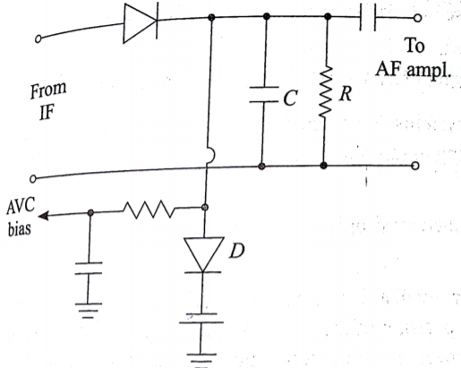
5. II Detector
Linear diode detector is used because of its simple circuit and low cost.
To keep the receiver output constant with time for any variations in input voltage, automatic voltage control (AVC) bias is obtained from this stage.
Variations in input voltage occurs due to fading or when the receiver is tuned from one station to another having different signal strength. AVC eliminates the effects of these variations.

Slide 14
AVC circuit samples a fraction of the detector output and convert it to AVC bias voltage, which is applied to RF and IF stages as negative bias.
As input of receiver increases, AVC bias voltage also increases and the negative bias to RF and IF amplifiers are increased thereby reducing the gain.
6. Audio Amplifier
RC coupled voltage amplifier followed by push pull power amplifier. Fidelity of receiver is determined by the frequency response characteristics of this stage.

Slide 15
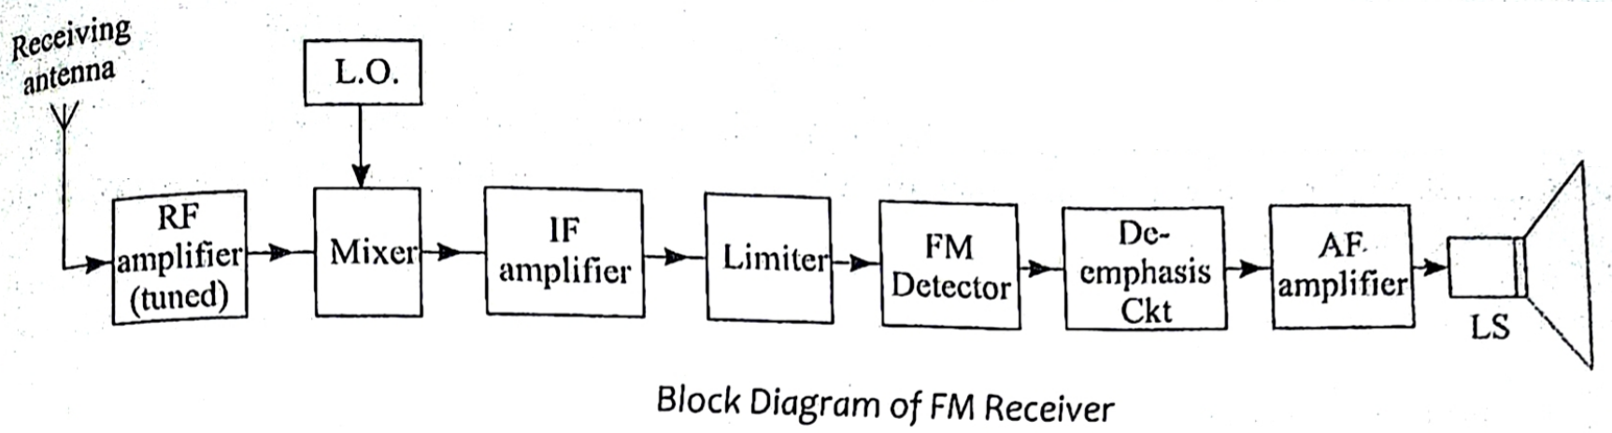
FM receiver
The function is to intercept the FM signal incoming from and FM transmitter and recover the original modulating signal.

Slide 16
RF Amplifier:
Amplifies the radio signal. FM uses RF range 40MHz to 1GHZ for various applications like FM broadcasting, police radio etc. RF amplifier also rejects image signal as in AM receivers.
2. Frequency mixer and Local oscillator
Separate active devices are used for mixer and LO as frequency involved is VHF and UHF. The IF of FM receiver is much higher than AM, IF =10.7MHz.
3. IF Amplifier
Amplifies the intermediate frequency signals. It comprises multistage double tuned or stagger tuned amplifiers to provide high gain and overall BW.

Slide 17
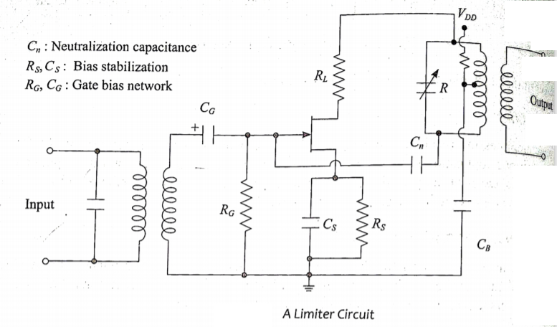
4. Limiter
Keeps the IF amplifier output voltage constant to a pre-determined value and removes the amplitude fluctuations due to noise. This is essential because FM detector needs constant amplitude FM voltage at input for satisfactory operations.
As the input increase, the bias at CS increases and gain of amplifier is reduced to keep output voltage constant.

Slide 18
5. FM detector
Recovers modulating signal from IF signal. De-emphasis circuit does the inverse job of pre-emphasis circuit. The high modulating frequency boosted by pre-emphasis are brought back to original amplitude level by de-emphasis circuit.
6. AF Amplifier and Speaker
Amplifies the audio frequency modulating signal recovered by FM detector. The loud speaker converts the electrical signal to the sound signal.

Slide 19
Noise
Undesired electrical signals which are introduced with a message signal during the transmission or processing are called Noise.
Noise may be predictable or unpredictable. The predictable noises can be estimated and eliminated by proper design. Eg: Power supply hum, spurious oscillations.
The unpredictable noise varies randomly with time and cannot be controlled. The amount of noise power decides the minimum power level of the desired message at the transmitter
Sources:
External noise : created outside the circuit. Includes Erratic Natural Disturbances and Man-made Noise.
Internal noise: Created by the active and passive components present within the communication circuit itself.

Slide 20
External Noises:
Erractic Noise Disturbances
This type of noise does not occur regularly. It is caused by lightning, electrical storms and other atmospheric disturbances.
This noise is unpredictable and known as atmospheric or static noise. It is less severe above 30MHz.
Man-made Noise
This noise is because of undesired pick-ups from electrical appliances such as motors, switch gears, automobile and aircraft ignitions etc.
This can be controlled and eliminated by removing the source of noise. It is effective in frequency range of 1MHz-500MHz.

Slide 21
Internal Noise:
Also known as fluctuation noise. It is caused by spontaneous fluctuations in the physical system.
Eg: (a) Thermal motion of free electrons inside resistors known as Brownian motion, which is random in nature.
(b) The random emission of electrons in vacuum tubes
(c) The random diffusion of electrons and holes in semiconductors
The fluctuation noise is very significant. Types:
Shot Noise
Thermal Noise

Slide 22
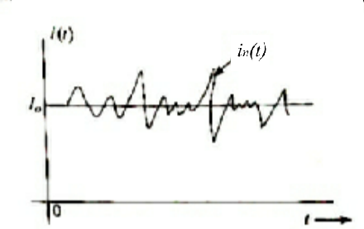
Shot Noise
Appears in active devices due to the random behaviour of charge carriers.
In electron tubes, the shot noise is generated due to random emission of electrons from cathode.
In semiconductors, it is caused due to the random diffusion of minority carriers or random generation and recombination of electrons and hole pairs.
Current in electron devices flows in the form of discrete pulses, every time a charge carrier moves from one point to other.
Although the current appears to be continuous it is still discrete phenomenon. The nature of current variation with time is shown:
The current fluctuates about mean value Io.
This current in(t) which wiggles around the mean
Value is known as Shot noise.
i(t) = Io + in(t)

Slide 23
Partition Noise:
The multigrid tubes (tetrode, pentode etc.) contain more than one grid and the partition of electrons emitted from cathode among the various grids is random in nature. This gives rise to another source of noise in multigrid tubes, called Partition Noise.
Flicker Noise:
Noise of his type arises due to imperfections in cathode surface of electron tubes and surfaces around the junctions of semiconductor devices.
Resistor Noise:
The noise arising due to random motion of free charged particles in conducting media such as resistor is called resistor noise or Johnson noise.
The intensity of random motion is proportional to thermal energy supplied, and is zero at temperature of absolute zero. This noise is also known as thermal noise.

Slide 24
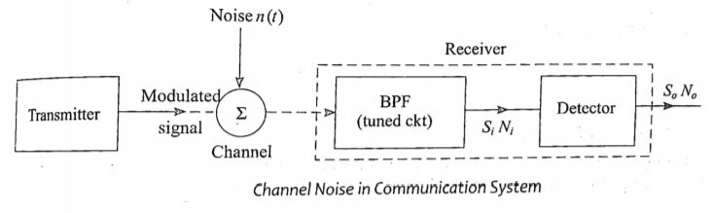
Noise in Amplitude modulated systems
In communication systems, message signal travels from the transmitter to the receiver via a channel.
The channel introduces additive noise in the message signal.
The noise characteristics of a modulation system is evaluated using a parameter known as figure of merit (γ).
It is defined as ratio of output signal to noise ratio to input signal to noise ratio of receiver.
Higher the value of γ, better will be the noise performance.

Slide 25
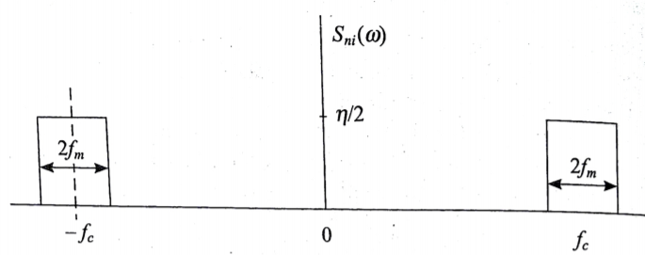
Calculation of Figure of Merit
The following assumptions are made for noise analysis:
Channel noise is additive
Channel noise is white and Gaussian:
The power spectrum of white noise n(t) is uniform over entire frequency band. The total noise power is thus obtained by multiplying the noise power density spectrum η/2 with bandwidth
N = (η/2 ) x Bandwidth
The noise amplitude has a Gaussian distribution.
(iii) Band pass noise at input of detector:
The bandpass filter at input of receiver allows a narrowband signal centered about ±fc and rejects other frequencies including noise. Thus the white noise at input of detector has power density spectrum shown.
The power density is Sni = η/2 .
(iv) Input noise power Ni
The input noise power is determined for baseband i.e. 2fm Hz.
Ni = (η/2 ) (2fm) = η fm.

Slide 26

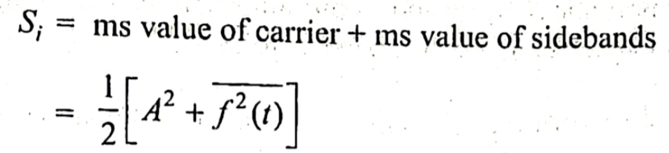

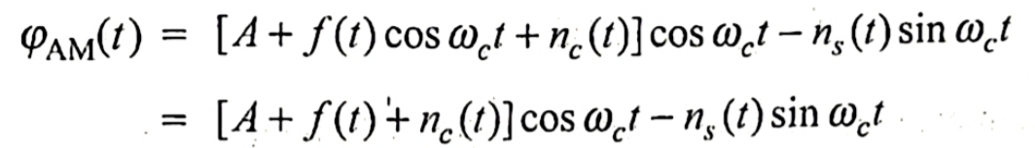

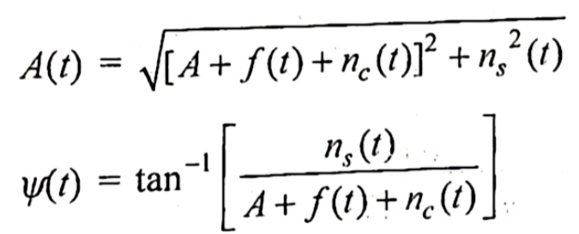
Noise calculation for Amplitude Modulation System (Envelope detector)
The input to the AM detector is given by (1)
The input signal power Si is given by
(2)
Output power:
Substituting quadrature representation for in equation (1),
After trigonometric manipulations,
Where

Slide 27

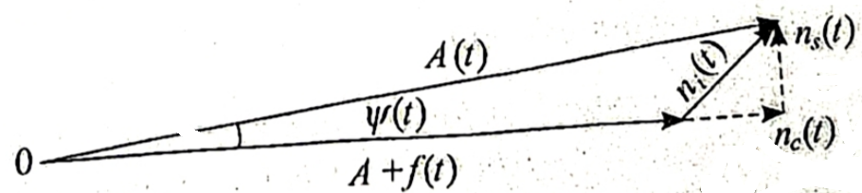




The envelope A(t) has both signal and noise components. The noise performance depends on relative magnitudes of signal and noise. The analysis can be carried out for two cases:
Small-Noise Case
Noise is taken to be much smaller than signal << [A+ f(t)]
The noise component is in-phase with signal
[A+ f(t)], is in phase quadrature. Since << [A+ f(t)], is also smaller than [A+ f(t)].
When is much small, then can be taken as zero.
Then, the envelope becomes

Slide 28
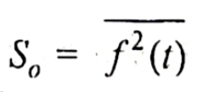



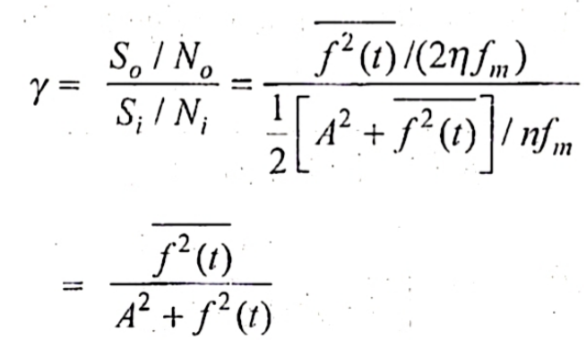
Output Signal Power So : The ms value of useful signal f(t)
(b) Output Noise power: The noise signal at the output of detector is with power density given by
The output noise power is
The figure of merit is thus given by

Slide 29
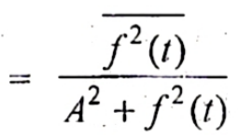
Figure of merit γ
The noise performance improves with reduction in carrier amplitude and is maximum when A =0 i.e. supressed carrier systems.
The greatest value of γ achieved depends on the minimum possible value of A, which is equal to maximum value of f(t) to avoid overmodulation.
Thus the best noise performance is achieved when A is equal to maximum value of f(t) i.e. 100% modulation.

Slide 30
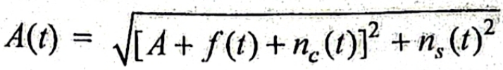
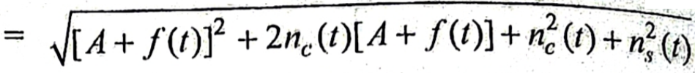
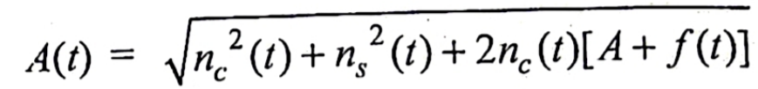
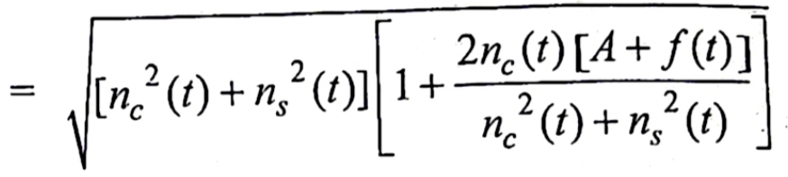
(ii) Large Noise case
Therefore, the quadrature component of also higher than [A+ f(t)].
The envelope of modulated signal is given by
Since noise components dominates over the signal, the first term can be ignored. Then
>> [A+ f(t)]

Slide 31
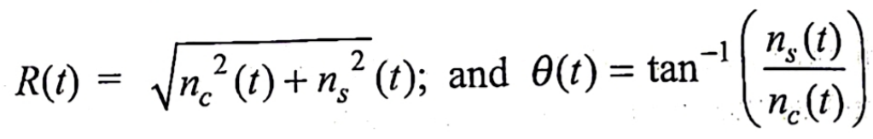
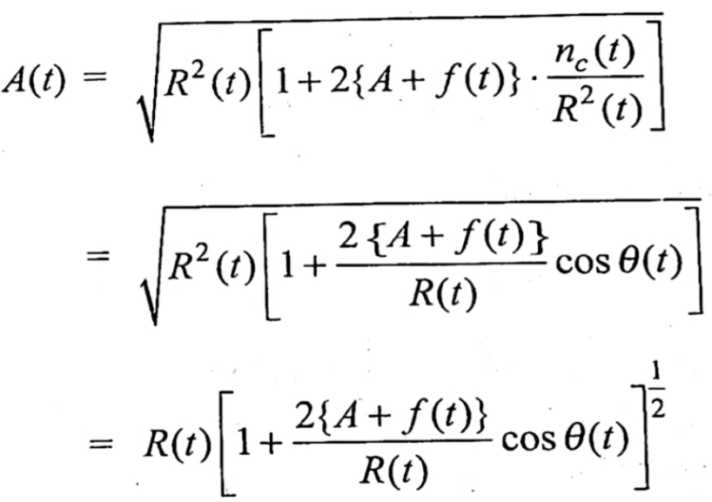
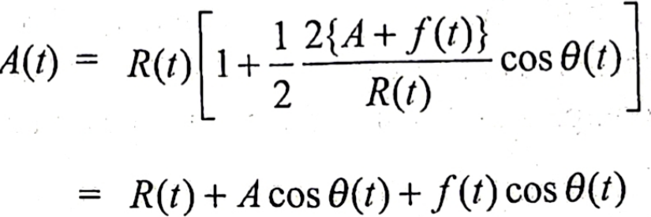

Putting
We get
Since the noise component ,
The envelope A(t) has no exclusive f(t) terms. As the modulating signal is completely mingled with noise, it caries no useful information. The loss of message f(t) in envelope detector due to large noise is referred to as threshold effect.

Slide 32
Threshold effect in an envelope detector
If the input SNR (Si/Ni) is below a certain level called threshold level, the noise dominates over message signal.
Threshold is defined as value of input SNR (Si/Ni) below which the output SNR (So/No) deteriorates much more rapidly than input SNR.
The threshold effect starts in an envelope detector whenever the carrier power to noise power ratio approaches unity or less.

